Slide 1
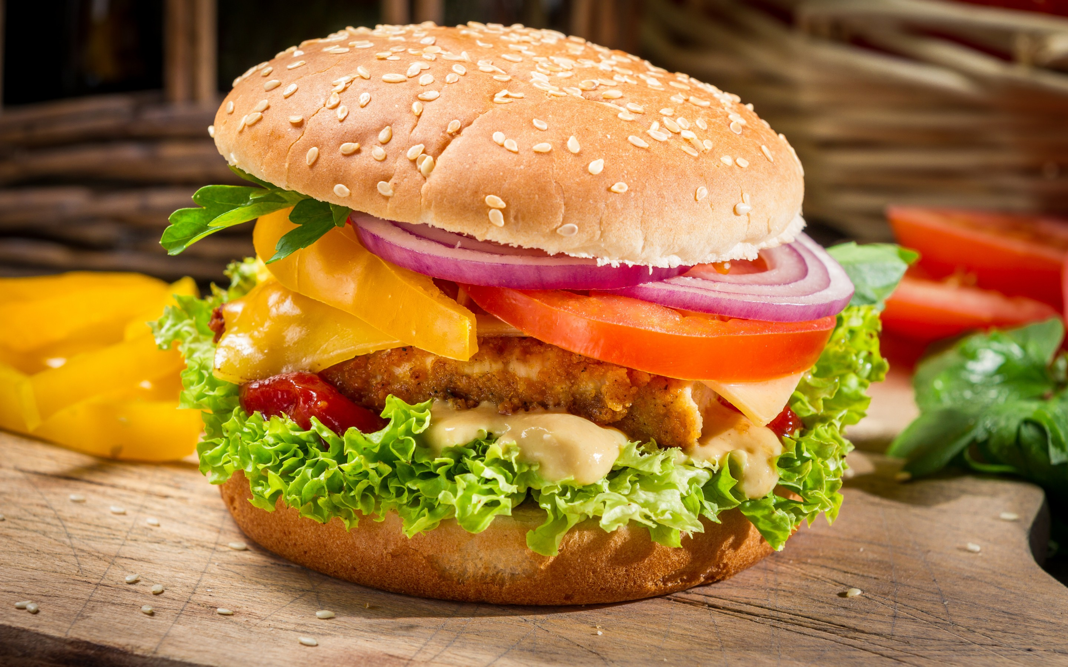
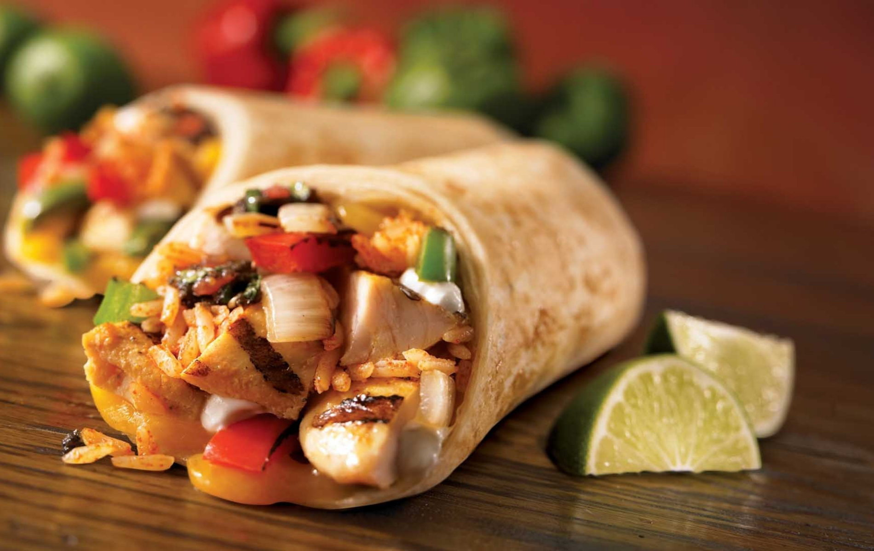
HUNGER F.FOOD
Samuel S

Slide 2
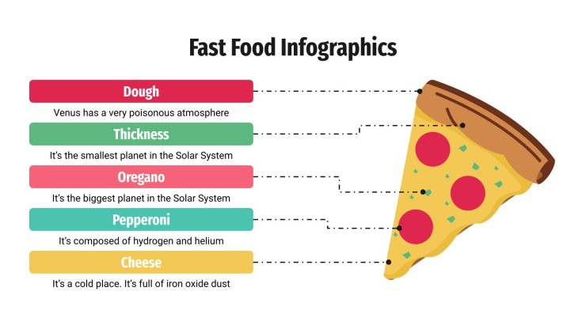
Agenda
Introduction
Industry Overview
Hunger's Unique Selling Proposition
SWOT Analysis
Competitor Analysis
Investment Details
Why Hunger Over Others

Slide 3
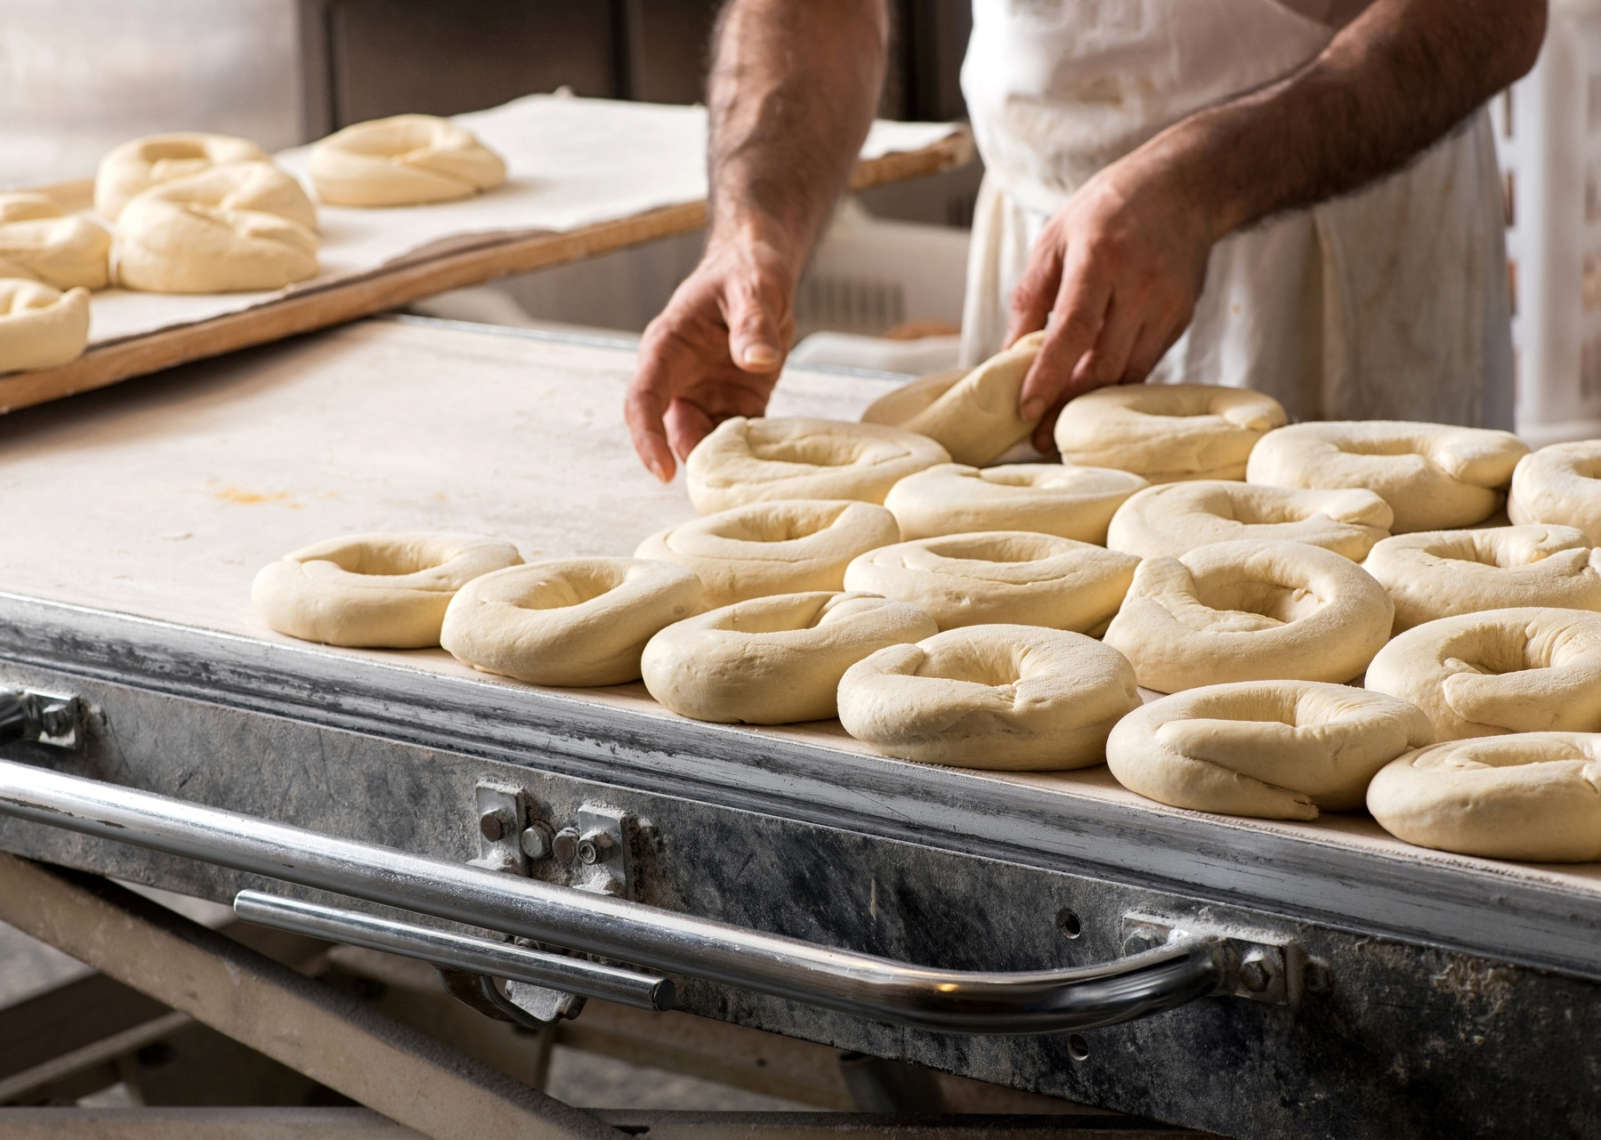
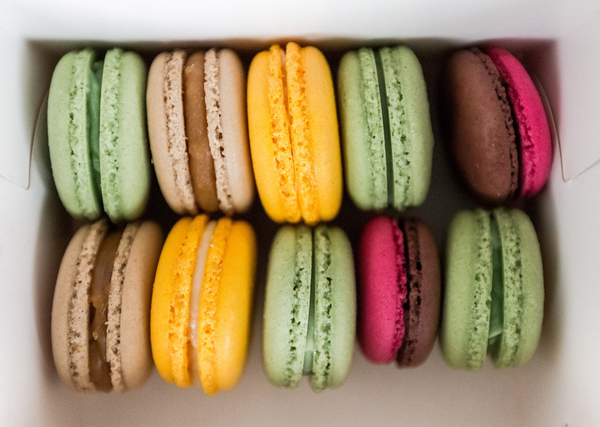
Introduction
"Welcome, esteemed guests. Today, I'm thrilled to unveil a lucrative opportunity in the food industry—Hunger. With a focus on pizza, burgers, and chicken-based fast food, Hunger emerges as a culinary trailblazer, offering not just a franchise but a flavorful investment. This journey promises a fusion of quality, efficiency, and a diverse menu, making Hunger the prime choice for entrepreneurial success. Join us as we explore why Hunger is the ultimate destination for those seeking a delectable and prosperous venture."

Slide 4
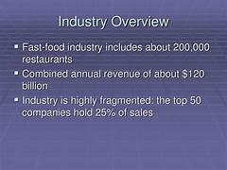

Fast food industry
As a result, the fast food industry began to grow across the globe, and today here we are in a world full of fast food chains. Currently, the fast food industry is worth $862.05 billion, and it is predicted to continue to grow at a rate of 6.05% in the next six years

Slide 5
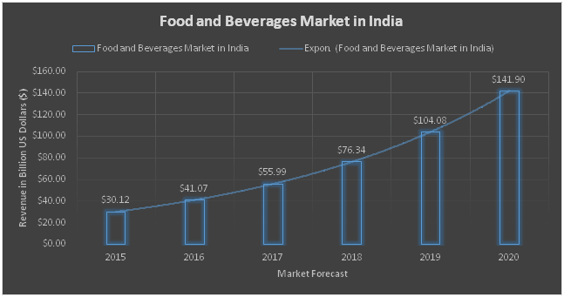
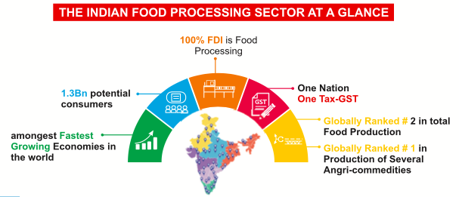
Chart

Slide 6
Hunger's Unique Selling Proposition
Set Hunger apart by offering a menu that fuses international flavors and culinary traditions. From globally-inspired pizza toppings to unique burger combinations and innovative chicken dishes, Hunger brings a world of taste to every bite.
Customization
"Immerse yourself in a culinary journey with Hunger's 'Create Your Own' concept. Tailor your pizza, burgers, and chicken meals by choosing from a diverse range of fresh ingredients and sauces, ensuring a uniquely satisfying experience crafted to individual tastes."
Health-Conscious
"Answer the call for healthier fast food with Hunger's special menu, featuring nutritious pizza crusts, lean burgers, and grilled or baked chicken options. We prioritize quality ingredients, providing health-conscious customers a guilt-free indulgence in every bite."
Combo Offers
Technology-Driven Ordering
"Enhance your dining delight with Hunger's appealing combo offers, featuring a delightful mix of pizzas, burgers, and chicken dishes at an irresistible price. Our carefully crafted combos cater to diverse tastes, promising a satisfying and value-packed meal for every customer."
"Revolutionize customer experience with Hunger's cutting-edge technology – an intuitive mobile app and online platform featuring virtual menus, loyalty programs, and contactless payments for seamless and modern ordering."
Globally Inspired Fusion Menu

Slide 7
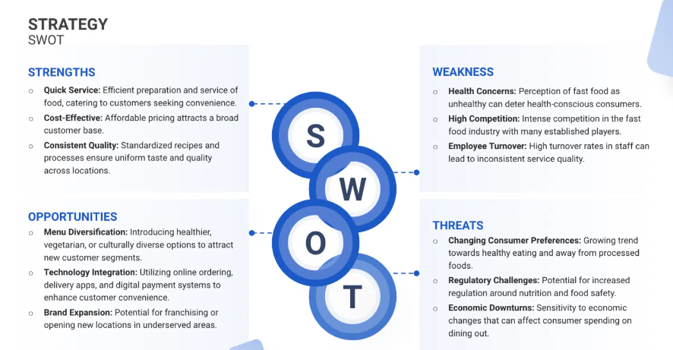
SWOT Analysis

Slide 8
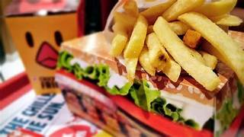
Strong Brand Recognition: Building a strong brand identity is crucial in the fast food industry. Establishing a recognizable and trusted brand can lead to customer loyalty and repeat business. Menu Diversification: Offering a diverse menu with a wide range of options can attract a broader customer base. Catering to various tastes and dietary preferences can increase sales and customer satisfaction. Efficient Supply Chain: Efficient supply chain management is essential for ensuring consistent quality and timely delivery of ingredients. A well-optimized supply chain can lead to cost savings and better customer satisfaction.
Strengths

Slide 9
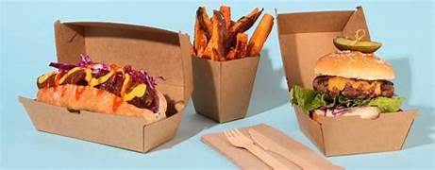
Health and Nutrition Concerns: As consumers become more health-conscious, fast food restaurants face scrutiny for offering high-calorie, low-nutrition options. Addressing these concerns is essential to stay competitive. Competitive Pricing Pressure: Price competition is fierce in the fast food industry. Maintaining profitability while keeping prices affordable can be a constant challenge. Quality Control Challenges: Maintaining consistent food quality across all locations can be challenging. Inconsistencies can lead to dissatisfied customers and damage the brand’s reputation.
Weaknesses

Slide 10
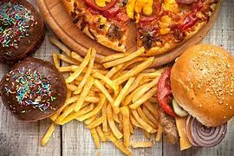
Healthy Menu Innovations: Embracing the trend toward healthier eating by introducing low-calorie, high-nutrition menu items can attract health-conscious customers. Online and Delivery Expansion: Investing in robust online ordering systems and delivery services can tap into the growing demand for convenience, especially in a post-pandemic world. Global Expansion: Exploring international markets can provide opportunities for growth and increased revenue. Adapting menus to local tastes and preferences is key to success.
Opportunities

Slide 11
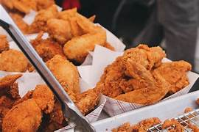
Health Regulations: Increasing health regulations and scrutiny can impact the fast food industry, leading to stricter menu labeling requirements and potential restrictions on certain ingredients Intense Competition: The fast food industry is highly competitive, with new entrants constantly emerging. Established chains must continually innovate to maintain their market share. Changing consumer preferences : Adapting to evolving consumer preferences, Hunger embraces diverse culinary trends, ensuring a dynamic menu that caters to the ever-changing tastes of our discerning customers.
Threats

Slide 12
Competitor Analysis
Competitor A
Competitor B
Established Brand Recognition
Recognized brand with a strong presence in the market.
Potential challenge: Hunger may need to invest in marketing to enhance its brand visibility.
Streamlined Operations
Efficient supply chain and operational processes leading to cost advantages.
Opportunity for Hunger: Implement lean practices to enhance operational efficiency.
Innovation in Menu Offerings
Constantly introduces new and trendy menu items.
Strategy for Hunger: Focus on unique recipes and diverse offerings to stay competitive in the evolving fast-food landscape.

Slide 13
INVESTMENT
INVESTMENT
KEY BENEFITS
DETAILS
Amount : ₹50 Lakhs
Space : 1000 sqft
ROI : 24 Months
Convenience and Quick Service
Time-Efficient Dining Solutions
Diverse and Varied Menu Options
Affordable Dining Choices
Innovative Offerings and Customization
Global Accessibility and Consistency
Place : Near IT Park
Type : Veg and NonVeg
Delivery: swiggy Zomato
Seating capacity: 35-45
Timing : 11am - 12 pm
Discounts : 5 to 10 percent(combo orders),special days

Slide 14



Why Hunger Over Others
Quality Ingredients
Unique and Diverse Menu
Standard Discounts
Efficient Operations and Quick Service
Continuous Menu Evolution
Diverse Menu Options
Innovation and Customization

Slide 15

THANK YOU
SAMUEL
morlensamuels@gmail.com

